Slide 1
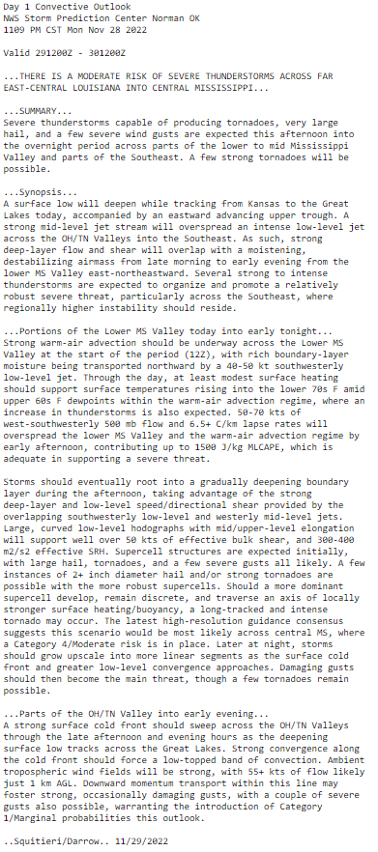
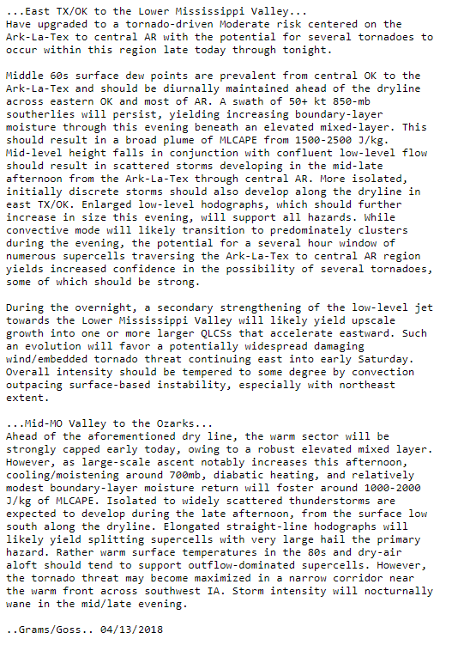
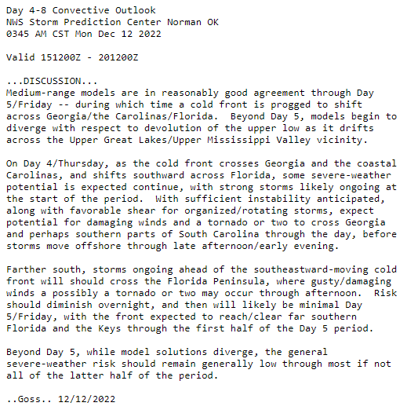
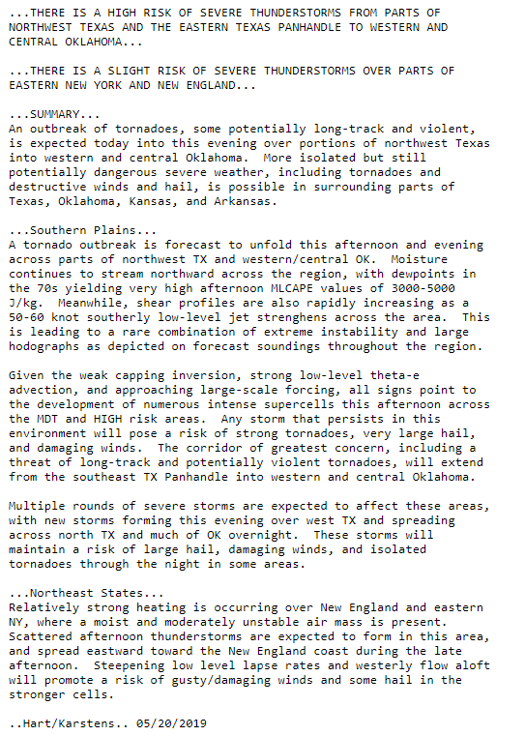
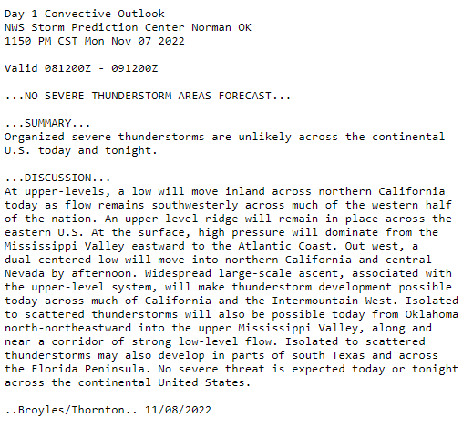
Writing Forecast Discussions
To answer in-class questions go to: pollev.com/severeclass641

Slide 2
Forecast Journals
Your task:
Use observations and short/long range models to create a series of SPC-style Day 1 convective outlooks.
Each journal will have three parts:
An SPC-style outlook graphic (categorical only, no individual hazards required)
A Day 1 forecast discussion.
Post event verification and discussion
Your forecast journal will NOT be graded on forecast accuracy, but WILL be graded on:
Meteorological concepts and consistency
Incorporation of various observation networks (no model-only forecasts)
Spelling and grammar
Please see the online rubric for further instructions and expectations.

Slide 3
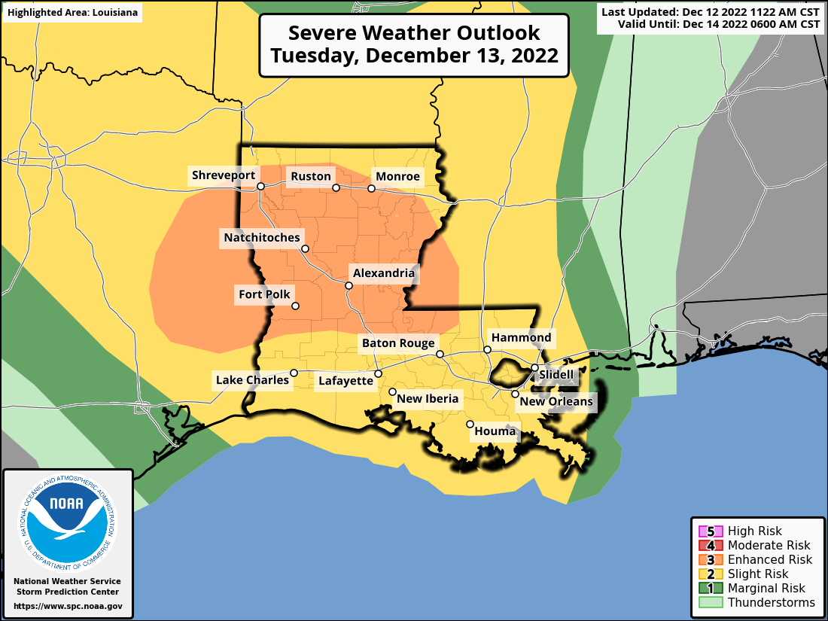
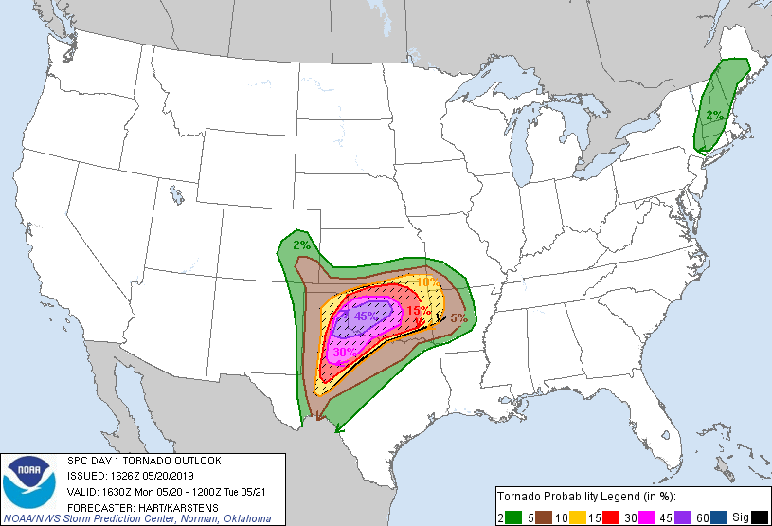
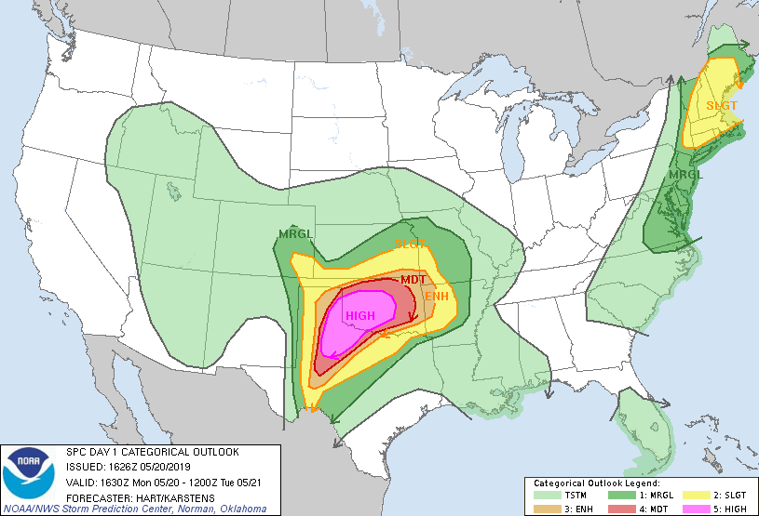
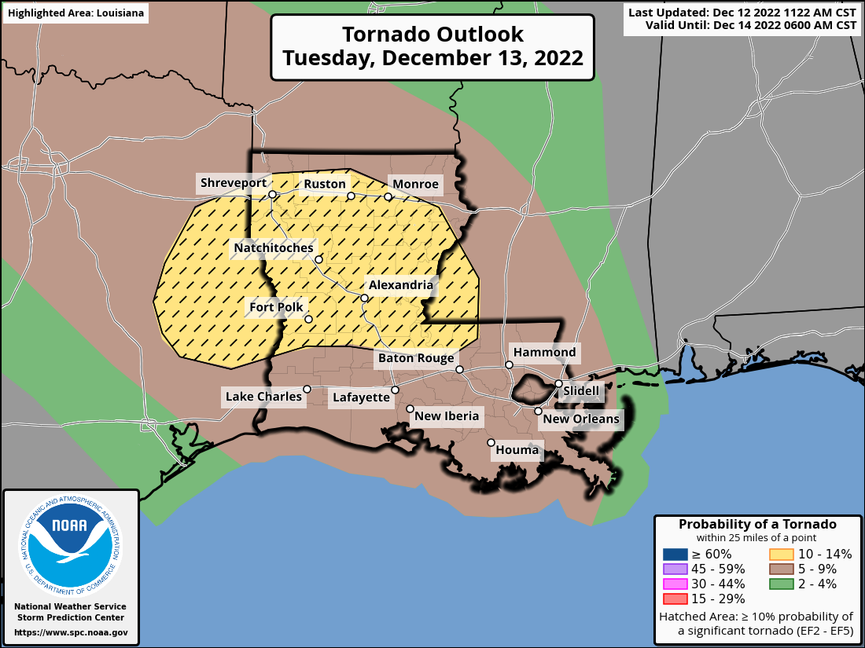
There are so many graphics
these days…
Why do we still bother with forecast discussions?

Slide 5
Graphics are great, but they can’t convey all of the forecast information
All of this text is needed to just explain the SPC Convective Outlook Graphic.
We can’t expect the public to know these details or the nuance of each forecast.
This nuance is best conveyed via the forecast discussion.

Slide 6
The most important concept:
Know your audience
Writing for other meteorologists:
WHAT
WHERE
WHEN
WHY
CONFIDENCE
POTENTIAL IMPACTS
Writing for decision makers and/or public:
WHAT
WHERE
WHEN
WHY
CONFIDENCE
POTENTIAL IMPACTS
Gives mets the scientific information they need to craft their local message to public/partners.
Allows decision makers and the public to make informed decisions and take action. They don’t necessarily care about “why” an event is occurring.
Notes:
Think about tornado warnings: The public does not need to know why a tornado is occurring, all they need to know is that a tornado is occurring, where it is, when it will arrive at their house, etc…

Slide 7
The most important concept:
Know your audience
Note: In this class we’re going to focus on the “WHY” to help build our intuition of severe weather forecasting.
Writing for other meteorologists:
WHAT
WHERE
WHEN
WHY
CONFIDENCE
POTENTIAL IMPACTS
Writing for decision makers and/or public:
WHAT
WHERE
WHEN
WHY
CONFIDENCE
POTENTIAL IMPACTS
Gives mets the scientific information they need to craft their local message to public/partners.
Allows decision makers and the public to make informed decisions and take action. They don’t necessarily care about “why” an event is occurring.
Notes:
Think about tornado warnings: The public does not need to know why a tornado is occurring, all they need to know is that a tornado is occurring, where it is, when it will arrive at their house, etc…

Slide 8
Anatomy of a Forecast Discussion
Summaries the main/most important point of the discussion. Ask yourself “If people take one thing away from my discussion, what is it?”
Example: “Strong to severe thunderstorms are possible after 3 PM today for central Oklahoma.”
Summary/Bottom Line Up Front
Discusses main synoptic features and how they should evolve over the forecast period. Example: “The surface low is forecast to deepen as it moves east into AR.”
Synopsis/Feature Identification
Goes into more regional-focused detail regarding the severe weather potential. Discusses how the convective environment should evolve, convective modes, trends, main hazards, etc...
Detailed Forecast Information
Conveys confidence in the forecast outlined above. Should include the most likely scenario as well as best/worst case potential outcomes and conditional risks.
Example: “A severe storm or two is possible if convection can initiate along the dryline before sunset.”
Confidence Communication

Slide 9
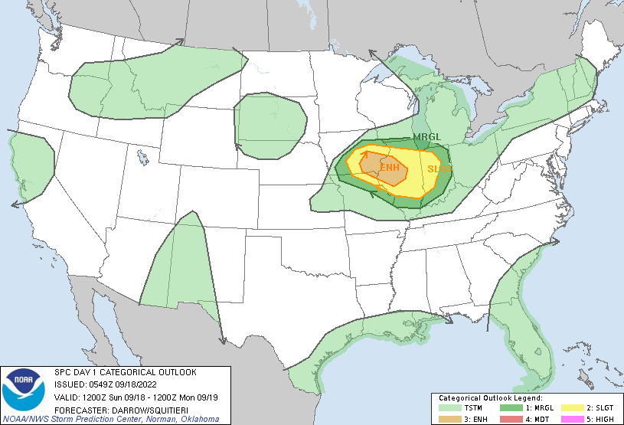
Anatomy of a Forecast Discussion
...THERE IS AN ENHANCED RISK OF SEVERE THUNDERSTORMS ACROSS PARTS OF
THE MID MISSISSIPPI VALLEY...
...SUMMARY...
Scattered severe thunderstorms should develop across the Mid
Mississippi Valley late Sunday afternoon. Hail, wind, and some
threat for a few tornadoes will spread toward central Illinois
during the evening hours.
...Mid Mississippi Valley...
Late-evening model guidance suggests upper ridge will build across
the southern Plains and strengthen during the day1 period. This
feature will force a notable short-wave trough currently located
over WY to top the ridge over eastern SD/NE around 18z before it
turns southeast and digs toward the OH Valley by 19/12z. As a
result, broad height rises will be noted across much of the
western/central US during the first half of the period.
Early this morning, thunderstorm clusters continue across southern
IA with more isolated activity into eastern KS. This activity is
likely being sustained by a focused LLJ that should move little over
the next 36hr, aside from veering toward central IL Sunday evening.
Remnants of this convection are expected to be ongoing at the
beginning of the period from southeast IA into central IL. Latest
guidance suggests weakening is likely after sunrise, though it may
not completely dissipate as it propagates southeast. While
marginally severe hail/wind could occur with this early-period
convection, the primary concern for more significant severe will
occur later in the afternoon/evening as influence of the
aforementioned short wave approaches.
Strong boundary-layer heating is forecast once again across KS where
surface temperatures may approach 100F in the central part of the
state. Readings into the low-mid 90s are possible across northwest
MO. If this occurs convective temperatures may be breached around
22z. There is some concern that isolated convection could develop
along the boundary shortly after peak heating but large-scale
forcing will not be particularly focused before sunset. However, as
the short wave digs southeast, scattered convection will likely
develop near the boundary over central IA. Forecast soundings favor
supercells, which should mature and dig east-southeast toward a very
unstable air mass with MUCAPE in excess of 4000 J/kg. Very steep
lapse rates and favorably forced/sheared environment suggest very
large hail with the stronger storms. Additionally, while these
updrafts may be slightly elevated, low-level shear appears favorable
for some risk of tornadoes. Latest HREF guidance supports this
scenario with a cluster of supercells evolving over IA and growing
upscale as they spread toward central IL during the late evening.
Damaging winds may also occur, especially if storm mergers and
bow-type features evolve.
Summaries the main/most important point of the discussion. Ask yourself “If people take one thing away from my discussion, what is it?”
Example: “Strong to severe thunderstorms are possible after 3 PM today for central Oklahoma.”
Example discussion from
06Z Day 1 Sept 18, 2022
Summary/Bottom Line Up Front
Discusses main synoptic features and how they should evolve over the forecast period. Example: “The surface low is forecast to deepen as it moves east into AR.”
Synopsis/Feature Identification
Goes into more regional-focused detail regarding the severe weather potential. Discusses how the convective environment should evolve, convective modes, trends, main hazards, etc...
Detailed Forecast Information
Conveys confidence in the forecast outlined above. Should include the most likely scenario as well as best/worst case potential outcomes and conditional risks.
Example: “A severe storm or two is possible if convection can initiate along the dryline before sunset.”
Confidence Communication
Notes:
Note: student’s don’t actually have to read the discussion. This is just to illustrate the point that SPC forecast discussions generally follow this outline. Students who are interested can go find this discussion from the 06 UTC outlook on Sept 18, 2022.

Slide 10
Content of a Forecast Discussion
Use words to paint a picture of the severe weather forecast!
Each point you make should serve the purpose of adding to the overall picture.

Slide 11
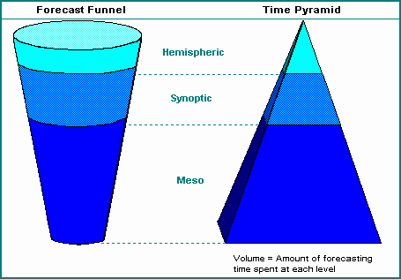
Content of a Forecast Discussion
Use the forecast funnel to structure your discussion.
Start at the synoptic scale
and work down!

Slide 12
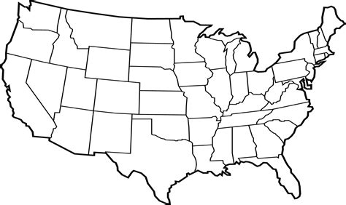
Content of a Forecast Discussion
A 500 mb trough will move east...
Use words to paint a picture of the severe weather forecast!
Each point you make should serve the purpose of adding to the overall picture.

Slide 13
Content of a Forecast Discussion
A 500 mb trough will move east...
Which will help deepen a low over NE...
Use words to paint a picture of the severe weather forecast!
Each point you make should serve the purpose of adding to the overall picture.
L

Slide 14
Content of a Forecast Discussion
A 500 mb trough will move east...
Which will help deepen a low over NE...
In response, southerly winds will increase and draw moisture northward into MO...
Use words to paint a picture of the severe weather forecast!
Each point you make should serve the purpose of adding to the overall picture.
L

Slide 15
Content of a Forecast Discussion
A 500 mb trough will move east...
Which will help deepen a low over NE...
In response, southerly winds will increase and draw moisture northward into MO...
The additional moisture and sunny conditions will
help increase CAPE by late afternoon...
Use words to paint a picture of the severe weather forecast!
Each point you make should serve the purpose of adding to the overall picture.
L

Slide 16
Content of a Forecast Discussion
A 500 mb trough will move east...
Which will help deepen a low over NE...
In response, southerly winds will increase and draw moisture northward into MO...
The additional moisture and sunny conditions will
help increase CAPE by late afternoon...
This will increase our thunderstorm chances by 4 PM.
Use words to paint a picture of the severe weather forecast!
Each point you make should serve the purpose of adding to the overall picture.
L

Slide 17
Content of a Forecast Discussion
A 500 mb trough will move east...
Which will help deepen a low over NE...
In response, southerly winds will increase and draw moisture northward into MO...
The additional moisture and sunny conditions will
help increase CAPE by late afternoon...
This will increase our thunderstorm chances by 4 PM.
Excellent Work!
Notice how nicely the discussion flows. Each line builds on the previous sentence and supports the next sentence, leading to main point!
L

Slide 18
Content of a Forecast Discussion
Keep in mind:
Use only as many words as necessary!
Calm weather = fewer words.
Impactful weather = more words.

Slide 19
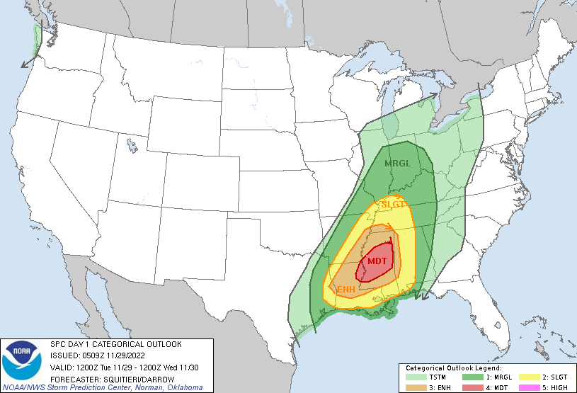
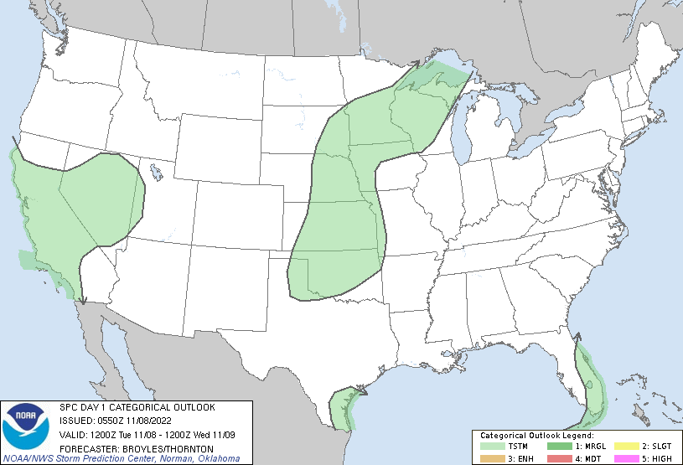
Content of a Forecast Discussion
High Impact
Low Impact

Slide 20
Group Discussion
As a class, let’s create a forecast discussion as we analyze weather data.

Slide 21
Expected 12z to 00z changes
Feature/Ingredient | Expected Change | Why?
500 mb trough
850 mb Trough/Low
850 mb Moisture (over west OK/KS)
Deep layer shear (over west OK/KS)

Slide 22
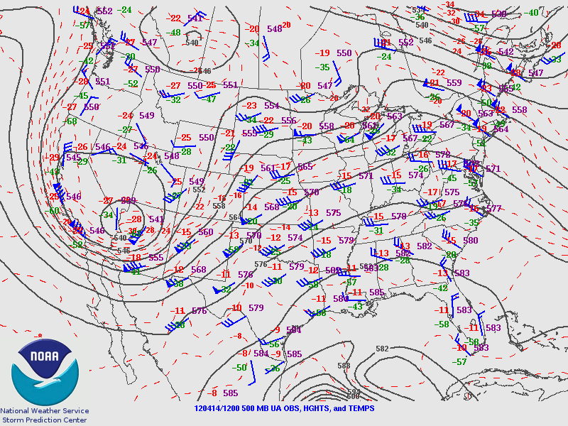
Question #2
Consider the 500 mb chart to the left…
Where will the low be in 12 hours?
What will happen to winds at 500 mb over western OK and KS?

Slide 23
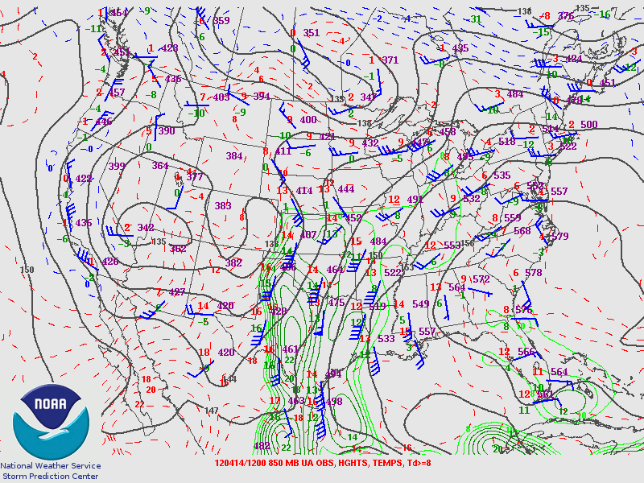
Question #2
Consider the 850 mb chart to the left…
Will the 850 mb low deepen?
What will this due to moisture content over northern OK/KS?

Slide 24
Expected 12z to 00z changes
Feature/Ingredient | Expected Change | Why?
500 mb trough
850 mb Trough/Low
850 mb Moisture (over west OK/KS)
Deep layer shear (over west OK/KS)

Slide 25
Expected 12z to 00z changes
Feature/Ingredient | Expected Change | Why?
500 mb trough | Translate east; minimal deepening | Eastward CVA (shortwave) Weak CAA underneath
850 mb Trough/Low
850 mb Moisture (over west OK/KS)
Deep layer shear (over west OK/KS)

Slide 26
Expected 12z to 00z changes
Feature/Ingredient | Expected Change | Why?
500 mb trough | Translate east; minimal deepening | Eastward CVA (shortwave) Weak CAA underneath
850 mb Trough/Low | Deepen; remain in place | DCVA over Rockies, Lee troughing, weak WAA
850 mb Moisture (over west OK/KS)
Deep layer shear (over west OK/KS)

Slide 27
Expected 12z to 00z changes
Feature/Ingredient | Expected Change | Why?
500 mb trough | Translate east; minimal deepening | Eastward CVA (shortwave) Weak CAA underneath
850 mb Trough/Low | Deepen; remain in place | DCVA over Rockies, Lee troughing, weak WAA
850 mb Moisture (over west OK/KS) | Increase | Northerly moisture advection
Deep layer shear (over west OK/KS)

Slide 28
Expected 12z to 00z changes
Feature/Ingredient | Expected Change | Why?
500 mb trough | Translate east; minimal deepening | Eastward CVA (shortwave) Weak CAA underneath
850 mb Trough/Low | Deepen; remain in place | DCVA over Rockies, Lee troughing, weak WAA
850 mb Moisture (over west OK/KS) | Increase | Northerly moisture advection
Deep layer shear (over west OK/KS) | Increase | Stronger 500 mb flow moving overhead as trough moves east

Slide 29
Expected 12z to 00z changes
Feature/Ingredient | Expected Change | Why?
500 mb trough | Translate east; minimal deepening | Eastward CVA (shortwave) Weak CAA underneath
850 mb Trough/Low | Deepen; remain in place | DCVA over Rockies, Lee troughing, weak WAA
850 mb Moisture (over west OK/KS) | Increase | Northerly moisture advection
Deep layer shear (over west OK/KS) | Increase | Stronger 500 mb flow moving overhead as trough moves east
These last two will increase the potential for organized, severe convection!
Notes:
What have we done? We looked at 3 maps and we can already make a reasonable guess that the severe weather potential could increase through 00Z. No models needed!

Slide 30
Concepts -> Discussion
Feature/Ingredient | Expected Change | Why?
500 mb trough | Translate east; minimal deepening | Eastward CVA (shortwave) Weak CAA underneath
Discussion Sentence(s)
The 500 mb trough noted in the 12Z analysis over southern Nevada is forecast to translate east through the day into the Four Corners region by 00Z with minimal deepening due to strong cyclonic vorticity advection atop of weak low to mid-level cold advection.
Notes:
Note: In a real-world discussion we wouldn’t say “diff cyclonic vort advection aloft” - it’s quite a mouthful! Instead we would typically say something like “broad-scale ascent ahead of the wave”. However, for the purposes of this class, we’ll be explicit.

Slide 31
Feature/Ingredient | Expected Change | Why?
850 mb Trough/Low | Deepen; remain in place | DCVA over Rockies, Lee troughing, weak WAA
Discussion Sentence(s)
A weak lee trough is noted at 850 mb from eastern CO southward into northeast NM. This lee trough will deepen through the day over eastern CO as strong differential cyclonic vorticity advcetion aloft overspreads the region in tandem with an increasing zonal flow component over the central Rockies.
Notes:
What have we done? We looked at 3 maps and we can already make a reasonable guess that the severe weather potential could increase through 00Z. No models needed!

Slide 32
Concepts -> Discussion
Feature/Ingredient | Expected Change | Why?
850 mb Trough/Low | Deepen; remain in place | DCVA over Rockies, Lee troughing, weak WAA
Discussion Sentence(s)
A weak lee trough is noted at 850 mb from eastern CO southward into northeast NM. This lee trough will deepen through the day over eastern CO as strong differential cyclonic vorticity advcetion aloft overspreads the region in tandem with an increasing zonal flow component over the central Rockies.
Notes:
What have we done? We looked at 3 maps and we can already make a reasonable guess that the severe weather potential could increase through 00Z. No models needed!

Slide 33
Feature/Ingredient | Expected Change | Why?
850 mb Moisture (over west OK/KS) | Increase | Northerly moisture advection
Deep layer shear (over west OK/KS) | Increase | Stronger 500 mb flow moving overhead as trough moves east
Discussion Sentence(s)
12Z analyses also revealed northward moisture advection across western TX and OK. This should help augment low to mid-level moisture across northwest OK and western to central KS by late afternoon. Additionally, deep layer wind shear is expected to increase by late afternoon/early evening as 500 mb flow strengthens in response to the approach of the upper-level trough and its associated jet streak. The combination of increasing moisture as well as deep-layer shear across northwest OK and KS may help enhance the potential for severe weather this afternoon and evening.
Notes:
What have we done? We looked at 2 maps and we can already make a reasonable guess that the severe weather potential could increase through 00Z. No models needed!

Slide 34
Our Map-Based Discussion
Synopsis
The 500 mb trough noted in the 12Z analysis over southern Nevada is forecast to translate east through the day into the Four Corners region by 00Z with minimal deepening due to strong cyclonic vorticity advection atop of weak low to mid-level cold advection.
A weak lee trough is noted at 850 mb from eastern CO southward into northeast NM. This lee trough will deepen through the day over eastern CO as strong differential cyclonic vorticity advection aloft overspreads the region in tandem with an increasing zonal flow component
over the central Rockies.
Northwest OK and KS Forecast Details
12Z analyses also revealed northward moisture advection across western TX and OK. This should help augment low to mid-level moisture across northwest OK and western to central KS by late afternoon.
Additionally, deep layer wind shear is expected to increase by late afternoon/early evening as 500 mb flow strengthens in response to the approach of the upper-level trough and its associated jet streak.
The combination of increasing moisture as well as deep-layer shear across northwest OK and KS may help enhance the potential for severe weather this afternoon and evening.

Slide 35
Same day… but now with soundings!
Expected 12z to 00z changes at OUN
Keep the previous upper-air maps in mind!
Feature/Ingredient | Expected Change | Why?
700 - 500 mb lapse rates
Lowest 100 mb mean mixing ratio

Slide 36
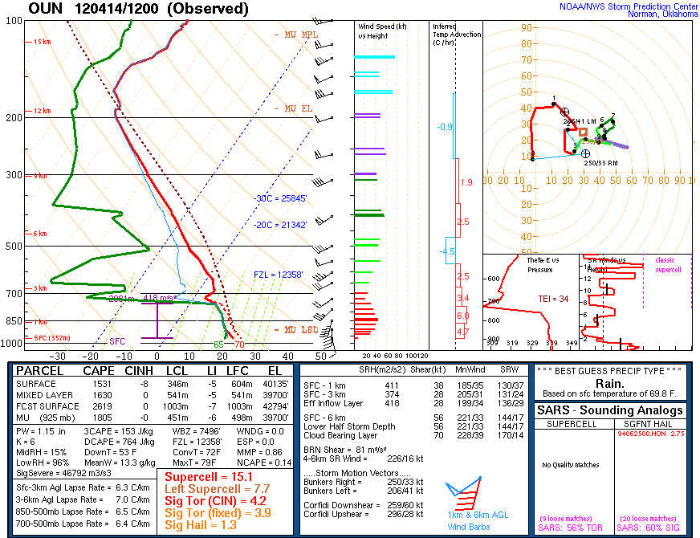
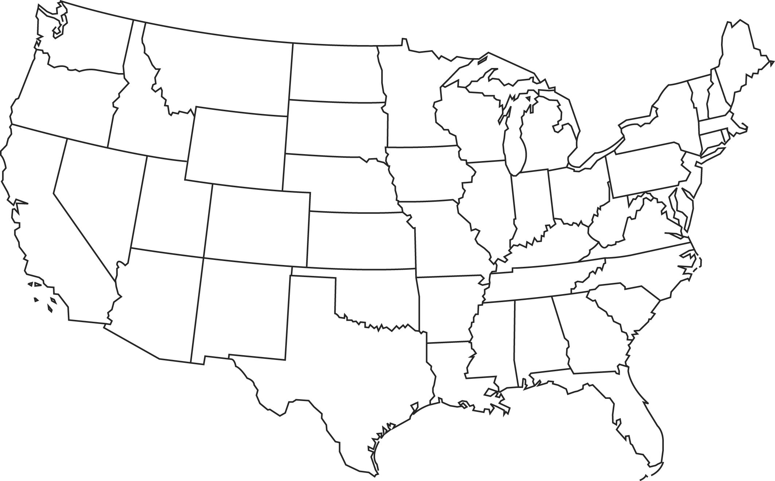
Conditionally Unstable Mid-level lapse rates
Saturated Layer near the surface.
Lots of clouds! What does this mean for daytime/diurnal heating potential?
Veering wind profile in the lowest 3 km. What does this say about thermal advection? Lift?

Slide 37
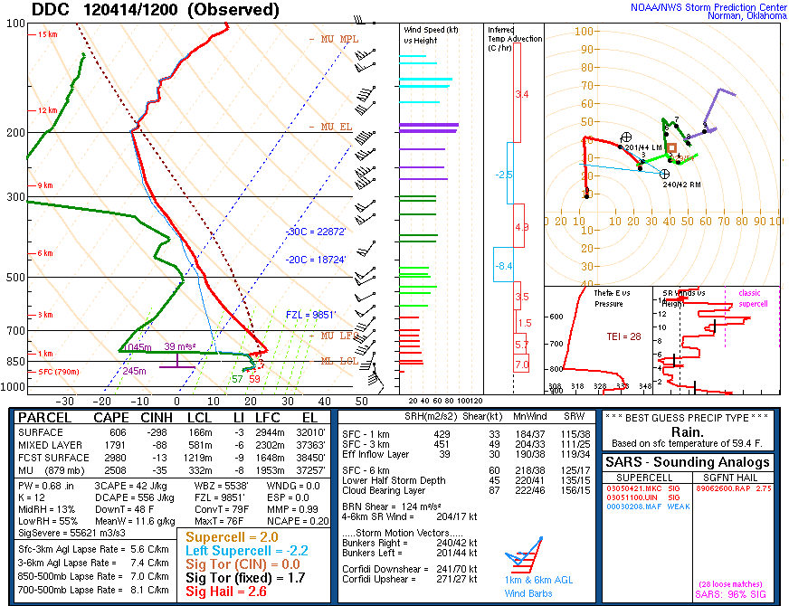
Note a ~300 mb elevated mixed layer. How does this compare to OUN?
Shallow, saturated boundary layer. Is this more or less moisture than OUN?
How easy will it be to mix out this cloud layer?

Slide 38
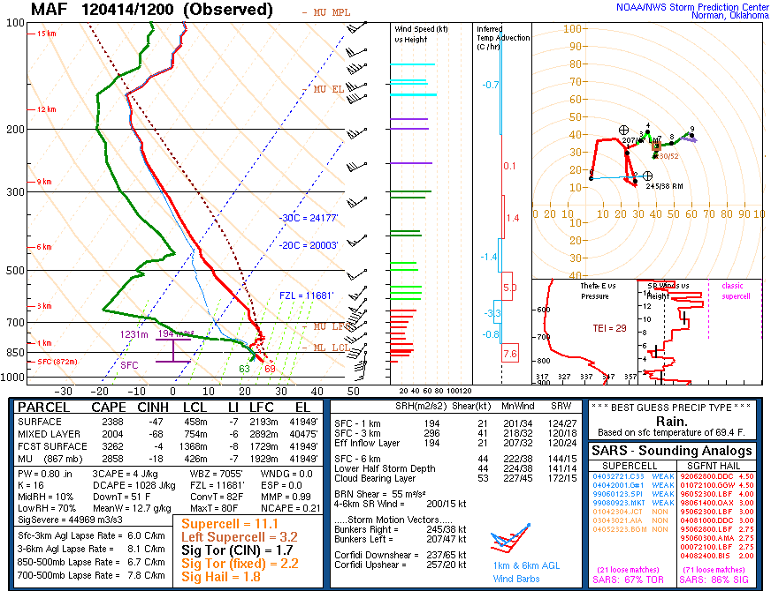
Note a 100-150 mb elevated mixed layer. How does this compare to OUN?
Shallow, saturated boundary layer. Is this more or less moisture than OUN?
How easy will it be to mix out this cloud layer?

Slide 39
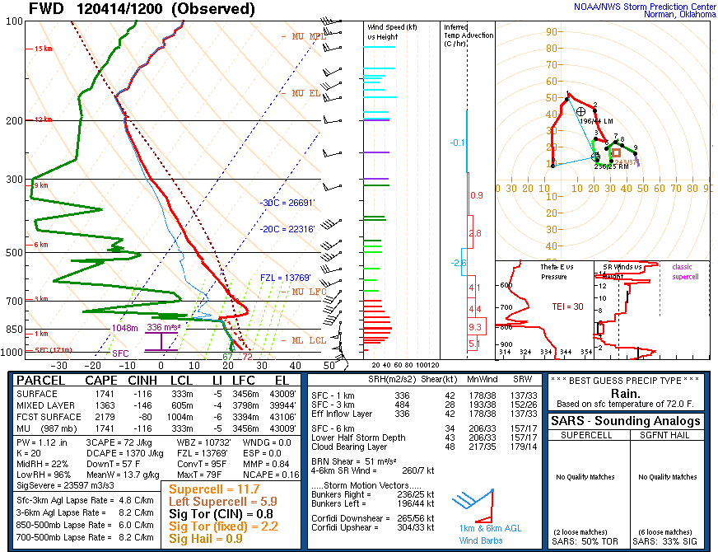
Notably warm temperatures at
~850 mb with the remnants of an elevated mixed layer above.
Deeper, saturated boundary layer. Is this more or less moisture than OUN? How easy will it be to mix out this cloud layer?

Slide 41
Same day… but now with soundings!
Expected 12z to 00z changes at OUN
Keep the previous upper-air maps in mind!
Feature/Ingredient | Expected Change | Why?
700 - 500 mb lapse rates
Lowest 100 mb mean mixing ratio

Slide 42
Same day… but now with soundings!
Expected 12z to 00z changes at OUN
Keep the previous upper-air maps in mind!
Feature/Ingredient | Expected Change | Why?
700 - 500 mb lapse rates | Steepen | WAA at 700 mb and neutral temperature advection at 500 mb from MAF. In other words, the eastward advection of an EML.
Lowest 100 mb mean mixing ratio

Slide 43
Same day… but now with soundings!
Expected 12z to 00z changes at OUN
Keep the previous upper-air maps in mind!
Feature/Ingredient | Expected Change | Why?
700 - 500 mb lapse rates | Steepen | WAA at 700 mb and neutral temperature advection at 500 mb from MAF. In other words, the eastward advection of an EML.
Lowest 100 mb mean mixing ratio | Remain about the same | Similar moisture content and depth upstream at FWD moving northward towards OUN. This mitigates the effect of vertical mixing as the boundary layer diurnally deepens!

Slide 44
Same day… but now with soundings!
Expected 12z to 00z changes at OUN
Steepening mid-level lapse rates while maintaining rich boundary-layer moisture will increase buoyancy!
Feature/Ingredient | Expected Change | Why?
700 - 500 mb lapse rates | Steepen | WAA at 700 mb and neutral temperature advection at 500 mb from MAF. In other words, the eastward advection of an EML.
Lowest 100 mb mean mixing ratio | Remain about the same | Similar moisture content and depth upstream at FWD moving northward towards OUN. This mitigates the effect of vertical mixing as the boundary layer diurnally deepens!
Notes:
Again, we used only 3 (!) soundings to make a reasonable assessment of the severe weather potential at 00 Z! No models needed!

Slide 45
Concepts -> Discussion
Feature/Ingredient | Expected Change | Why?
700 - 500 mb lapse rates | Steepen | WAA at 700 mb and neutral temperature advection at 500 mb from MAF. In other words, the eastward advection of an EML.
Discussion Sentence(s)
Morning regional soundings show steep mid-level lapse rates within an EML over west TX and SW KS that will likely overspread into OK and central KS within a west/southwesterly flow regime within the 700-500 mb layer. This will likely result in steepening lapse rates over OK by 00Z.
Notes:
Note: In a real-world discussion we wouldn’t say “diff cyclonic vort advection aloft” - it’s quite a mouthful! Instead we would typically say something like “broad-scale ascent ahead of the wave”. However, for the purposes of this class, we’ll be explicit.

Slide 46
Concepts -> Discussion
Feature/Ingredient | Expected Change | Why?
Lowest 100 mb mean mixing ratio | Remain about the same | Similar moisture content and depth upstream at FWD moving northward towards OUN. This mitigates the effect of vertical mixing as the boundary layer diurnally deepens!
Discussion Sentence(s)
Notes:
Note: In a real-world discussion we wouldn’t say “diff cyclonic vort advection aloft” - it’s quite a mouthful! Instead we would typically say something like “broad-scale ascent ahead of the wave”. However, for the purposes of this class, we’ll be explicit.

Slide 48
Concepts -> Discussion
Feature/Ingredient | Expected Change | Why?
Lowest 100 mb mean mixing ratio | Remain about the same | Similar moisture content and depth upstream at FWD moving northward towards OUN. This mitigates the effect of vertical mixing as the boundary layer diurnally deepens!
Discussion Sentence(s)
The 12Z OUN sounding reveals a deep, saturated boundary-layer. Overcast skies, coupled with continued warm air advection within the lowest 3 km, may hinder diurnal heating and boundary layer mixing to a degree, which will help maintain low-level moisture through the day. Any vertical mixing of moisture that does occur will likely be replenished by ample boundary-layer moisture noted in the upstream FWD sounding.
Notes:
Note: In a real-world discussion we wouldn’t say “diff cyclonic vort advection aloft” - it’s quite a mouthful! Instead we would typically say something like “broad-scale ascent ahead of the wave”. However, for the purposes of this class, we’ll be explicit.

Slide 49
Our Sounding-Based Discussion
12Z Sounding analysis suggests that the convective environment should become more favorable for severe convection across central OK by 00Z as instability increases.
Morning regional soundings show steep mid-level lapse rates within an EML over west TX and SW KS that will likely overspread into OK and central KS within a west/southwesterly flow regime within the 700-500 mb layer. This will likely result in steepening lapse rates over OK by 00Z.
The 12Z OUN sounding reveals a deep, saturated boundary-layer. Overcast skies, coupled with continued warm air advection within the lowest 3 km, may hinder diurnal heating and boundary layer mixing to a degree, which will help maintain low-level moisture through the day. Any vertical mixing of moisture that does occur will likely be replenished by ample boundary-layer moisture noted in the upstream FWD sounding.
The combination of steepening lapse rates atop ample boundary-layer moisture will help increase instability by late afternoon.

Slide 50
Same day… but now with satellite!
Expected 12z to 00z changes for OK and KS
Keep the previous data in mind!
Feature/Ingredient | Expected Change | Why?
Cloud Cover
Diurnal Heating Efficiency

Slide 51
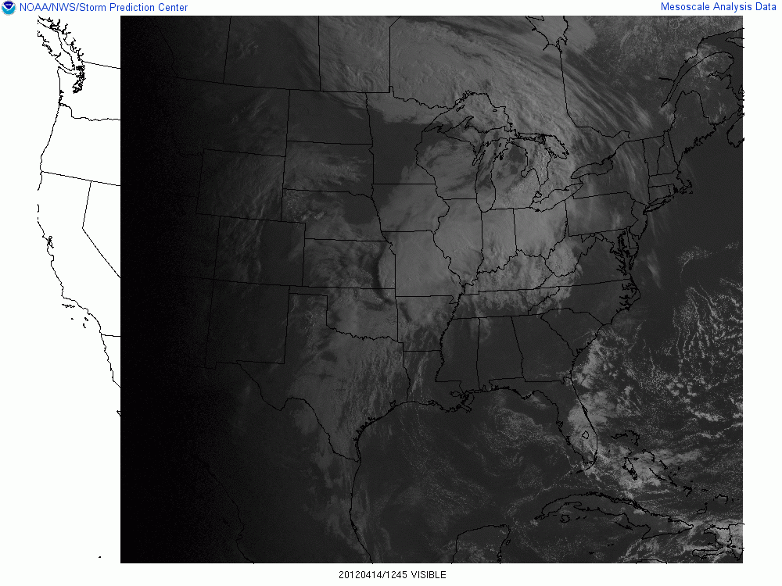
12:45 Z Visible
More scattered/broken clouds over KS
Why?
Remnant MCS
Overcast for central OK
Why?
Clearing skies for SW KS and the OK/TX Panhandles
Why?

Slide 52
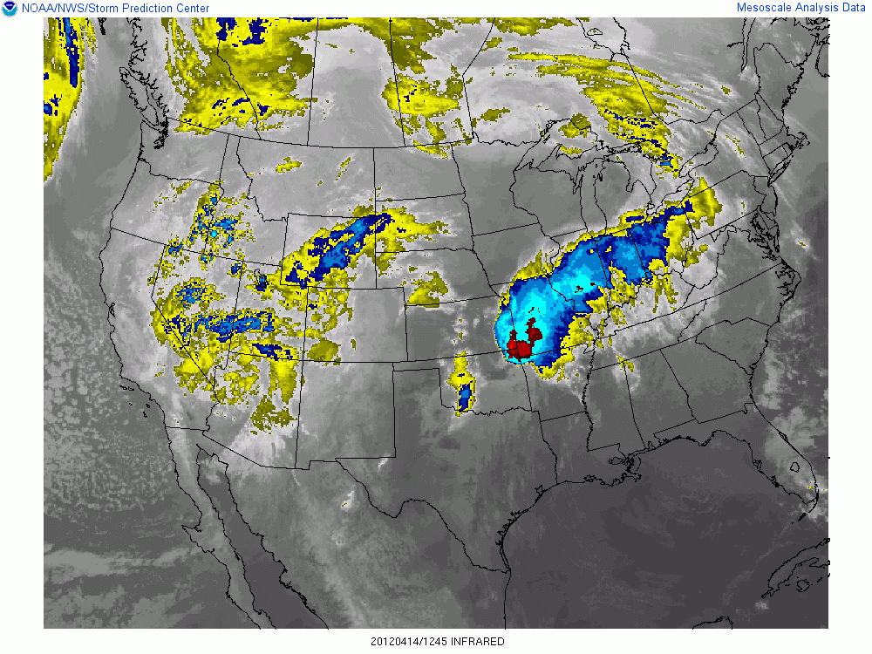
12:45 Z IR
Shallower clouds over KS
Remnant MCS
Clearing skies for SW KS
and Panhandles
Stratus Deck and deeper/high level clouds

Slide 53
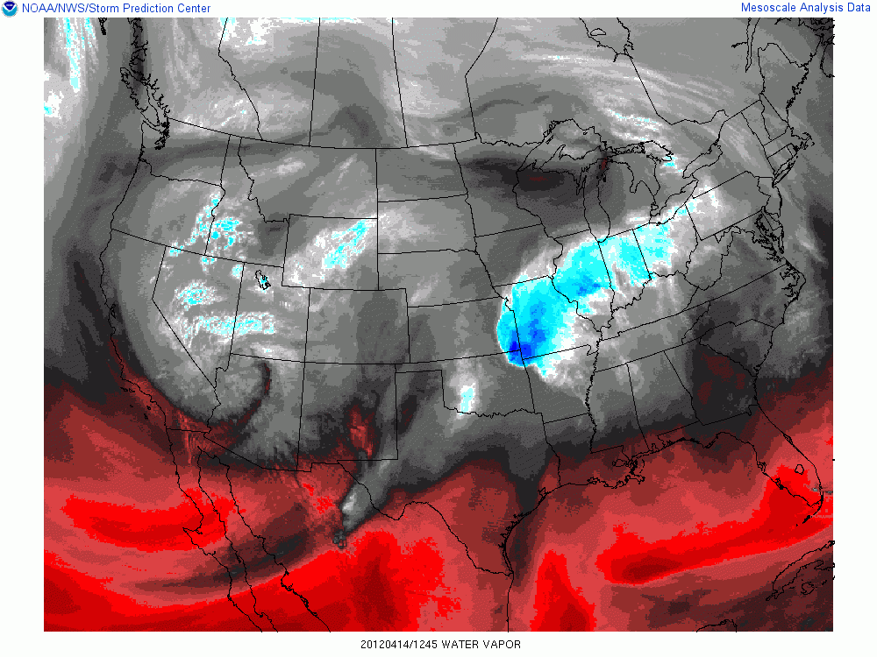
12:45 Z Water Vapor
Leading shortwave impulse?
Drier air overspreading KS
(remember the EML from the DDC sounding?)
Upper-level low/Vorticity Maxima

Slide 55
Same day… but now with satellite!
Expected 12z to 00z changes for OK and KS
Keep the previous data in mind!
Feature/Ingredient | Expected Change | Why?
Cloud Cover
Diurnal Heating Efficiency

Slide 56
Same day… but now with satellite!
Expected 12z to 00z changes for OK and KS
Keep the previous data in mind!
Feature/Ingredient | Expected Change | Why?
Cloud Cover | Continued clearing for NW OK (until convection develops) | Dry air at mid-upper levels overspreading SW KS (from water vapor imagery) with early signs of partial clearing in visible imagery. Also, the saturated boundary layer at DDC is shallower/easier to mix out by afternoon.
Diurnal Heating Efficiency

Slide 57
Same day… but now with satellite!
Expected 12z to 00z changes for OK and KS
Keep the previous data in mind!
Feature/Ingredient | Expected Change | Why?
Cloud Cover | Continued clearing for NW OK (until convection develops) | Dry air at mid-upper levels overspreading SW KS (from water vapor imagery) with early signs of partial clearing in visible imagery. Also, the saturated boundary layer at DDC is shallower/easier to mix out by afternoon.
Diurnal Heating Efficiency | Strong diurnal heating for NW OK. | Fewer clouds will allow for better diurnal warming.

Slide 58
Concepts -> Discussion
Feature/Ingredient | Expected Change | Why?
Cloud Cover | Continued clearing for NW OK (until convection develops) | Dry air at mid-upper levels overspreading SW KS (from water vapor imagery) with early signs of partial clearing in visible imagery. Also, the saturated boundary layer at DDC is shallower/easier to mix out by afternoon.
Discussion Sentence(s)
Recent satellite imagery shows a stratus deck over central OK with decreasing clouds to the north/northwest into NW OK. Drier air aloft overspreading SW KS (per water vapor imagery) and gradual mixing of a shallow moist boundary layer (per the 12 Z DDC sounding) may allow for mostly clear to partly cloudy skies by early afternoon.

Slide 59
Concepts -> Discussion
Here we tie in the observed trends directly into our severe weather forecast!
Feature/Ingredient | Expected Change | Why?
Diurnal Heating Efficiency | Poor diurnal heating for central OK; better diurnal heating for SW KS. | Cloud cover will likely persist for central OK, fewer clouds are expected for SW KS.
Discussion Sentence(s)
Mostly clear to partly cloudy skies across northwest OK into KS will allow for strong daytime heating and aid in destabilization by late afternoon.

Slide 61
Our Satellite-Based Discussion
Recent satellite imagery shows a stratus deck over central OK with decreasing clouds to the north/northwest into NW OK. Drier air aloft overspreading SW KS (per water vapor imagery) and gradual mixing of a shallow moist boundary layer (per the 12 Z DDC sounding)
may allow for mostly clear to partly cloudy skies by early afternoon.
Mostly clear to partly cloudy skies across northwest OK into KS will allow for strong daytime heating and aid in destabilization by late afternoon.

Slide 62
Our Combined Discussion
Synopsis
The 500 mb trough noted in the 12Z analysis over southern Nevada is forecast to translate east through the day into the Four Corners region by 00Z with minimal deepening due to strong cyclonic vorticity advection atop of weak low to mid-level cold advection. A weak lee trough is noted at 850 mb from eastern CO southward into northeast NM. This lee trough will deepen through the day over eastern CO as strong differential cyclonic vorticity advection aloft overspreads the region in tandem with an increasing zonal flow component
over the central Rockies.
Northwest OK Forecast Details
12Z analyses also revealed northward moisture advection across western TX and OK. This should help augment low to mid-level moisture across northwest OK and western to central KS by late afternoon. Additionally, deep layer wind shear is expected to increase by late afternoon/early evening as 500 mb flow strengthens in response to the approach of the upper-level trough and its associated jet streak. The combination of increasing moisture as well as deep-layer shear across northwest OK and KS may help enhance the potential for severe weather this afternoon and evening.
12Z Sounding analysis suggests that the convective environment should become more favorable for severe convection across central OK by 00Z as instability and deep-layer shear increase. Morning regional soundings show steep mid-level lapse rates within an EML over west TX and SW KS that will likely overspread into OK and central KS within a west/southwesterly flow regime within the 700-500 mb layer. This will likely result in steepening lapse rates over OK by 00Z. The 12Z OUN sounding reveals a deep, saturated boundary-layer. Overcast skies, coupled with continued warm air advection within the lowest 3 km, may hinder diurnal heating and boundary layer mixing to a degree, which will help maintain low-level moisture through the day. Any vertical mixing of moisture that does occur will likely be replenished by ample boundary-layer moisture noted in the upstream FWD sounding. The combination of steepening lapse rates atop ample boundary-layer moisture will help increase instability by late afternoon. Mid to upper-level winds are forecast to strengthen through the afternoon and evening as stronger flow associated with the approaching upper-level trough across the West shifts east through the day. Given the southerly low-level flow noted in the 12 UTC OUN sounding (which will likely be maintained, if not augmented, as surface pressure falls to the north/northwest), this will likely result in an increase in 0-6 km bulk shear over central OK.
Recent satellite imagery shows a stratus deck over central OK with decreasing clouds to the north/northwest into KS. Continued low to mid-level warm advection within a moist boundary layer should maintain cloud cover for much of the day for central OK, while drier air aloft overspreading SW KS (per water vapor imagery) and gradual mixing of a shallow moist boundary layer (noted in the 12 Z DDC sounding) may allow for mostly clear to partly cloudy skies. Persistent cloud cover over central OK should limit the degree of daytime heating. However, mostly clear to partly cloudy skies further north/northwest into KS will allow for at least modest daytime heating and aid in destabilization by late afternoon.
Information from 500 mb and 850 mb charts
Sounding Information
Satellite Information

Slide 63
Our Refined Discussion
Synopsis
The 500 mb trough noted in the 12Z analysis over southern Nevada is forecast to translate east through the day into the Four Corners region by 00Z with minimal deepening due to strong cyclonic vorticity advection atop of weak low to mid-level cold advection. A weak lee trough is noted at 850 mb from eastern CO southward into northeast NM. This lee trough will deepen through the day over eastern CO as strong differential cyclonic vorticity advection aloft overspreads the region in tandem with an increasing zonal flow component over the central Rockies.
Northwest OK Forecast Details
Northward low to mid-level moisture advection is noted across TX and central OK in 12Z analyses and regional soundings. This should help augment low to mid-level moisture across northwest OK and western to central KS by late afternoon. This moist, warm air advection regime over OK may help maintain boundary-layer moisture and overcast skies (noted in morning visible satellite imagery), which could limit the degree of daytime heating. Further north/northwest into KS, the 12 DDC sounding revealed a saturated, but shallow, boundary-layer that may be more susceptible to diurnal mixing. Visible and IR imagery support this idea by showing a shallow, scattered cloud deck. Additionally, morning regional soundings show steep mid-level lapse rates within an EML over west TX and SW KS that will likely overspread into OK and central KS within a west/southwesterly flow regime within the 700-500 mb layer. Drier air associated with this EML is noted in morning water vapor imagery, and will likely result in steepening lapse rates over OK by 00Z. The net result of these effects will be to promote increasing instability across northwest OK into KS with modest increases in instability further south into central OK.
500 mb flow is expected to strengthen through the day in response to the approach of the upper-level trough and its associated jet streak. Given the southerly low-level flow noted in the 12 UTC OUN and DDC soundings (which will likely be maintained, if not augmented, as surface pressure falls to the northwest), this will likely result in an increase in 0-6 km bulk shear over OK and KS. As a result, wind profiles will become more favorable for supporting severe convection heading into the afternoon and evening hours.
Here we simply consolidated similar topics into the same sentence.
Remember: There’s no need to say the same thing twice in two different places!

Slide 64
Our Refined Discussion
Summary
Severe thunderstorms appear likely this afternoon and evening across northwest OK.
Synopsis
The 500 mb trough noted in the 12Z analysis over southern Nevada is forecast to translate east through the day into the Four Corners region by 00Z with minimal deepening due to strong cyclonic vorticity advection atop of weak low to mid-level cold advection. A weak lee trough is noted at 850 mb from eastern CO southward into northeast NM. This lee trough will deepen through the day over eastern CO as strong differential cyclonic vorticity advection aloft overspreads the region in tandem with an increasing zonal flow component over the central Rockies.
Northwest OK Forecast Details
Northward low to mid-level moisture advection is noted across TX and central OK in 12Z analyses and regional soundings. This should help augment low to mid-level moisture across northwest OK and western to central KS by late afternoon. This moist, warm air advection regime over OK may help maintain boundary-layer moisture and overcast skies (noted in morning visible satellite imagery), which could limit the degree of daytime heating. Further north/northwest into KS, the 12 DDC sounding revealed a saturated, but shallow, boundary-layer that may be more susceptible to diurnal mixing. Visible and IR imagery support this idea by showing a shallow, scattered cloud deck. Additionally, morning regional soundings show steep mid-level lapse rates within an EML over west TX and SW KS that will likely overspread into OK and central KS within a west/southwesterly flow regime within the 700-500 mb layer. Drier air associated with this EML is noted in morning water vapor imagery, and will likely result in steepening lapse rates over OK by 00Z. The net result of these effects will be to promote increasing instability across northwest OK into KS with modest increases in instability further south into central OK.
500 mb flow is expected to strengthen through the day in response to the approach of the upper-level trough and its associated jet streak. Given the southerly low-level flow noted in the 12 UTC OUN and DDC soundings (which will likely be maintained, if not augmented, as surface pressure falls to the northwest), this will likely result in an increase in 0-6 km bulk shear over OK and KS. As a result, wind profiles will become more favorable for supporting severe convection heading into the afternoon and evening hours.
Let’s add in a summary!

Slide 65
Our Refined Discussion
Summary
Severe thunderstorms appear likely this afternoon and evening across northwest OK.
Synopsis
The 500 mb trough noted in the 12Z analysis over southern Nevada is forecast to translate east through the day into the Four Corners region by 00Z with minimal deepening due to strong cyclonic vorticity advection atop of weak low to mid-level cold advection. A weak lee trough is noted at 850 mb from eastern CO southward into northeast NM. This lee trough will deepen through the day over eastern CO as strong differential cyclonic vorticity advection aloft overspreads the region in tandem with an increasing zonal flow component over the central Rockies.
Northwest OK Forecast Details
Northward low to mid-level moisture advection is noted across TX and central OK in 12Z analyses and regional soundings. This should help augment low to mid-level moisture across northwest OK and western to central KS by late afternoon. This moist, warm air advection regime over OK may help maintain boundary-layer moisture and overcast skies (noted in morning visible satellite imagery), which could limit the degree of daytime heating. Further north/northwest into KS, the 12 DDC sounding revealed a saturated, but shallow, boundary-layer that may be more susceptible to diurnal mixing. Visible and IR imagery support this idea by showing a shallow, scattered cloud deck. Additionally, morning regional soundings show steep mid-level lapse rates within an EML over west TX and SW KS that will likely overspread into OK and central KS within a west/southwesterly flow regime within the 700-500 mb layer. Drier air associated with this EML is noted in morning water vapor imagery, and will likely result in steepening lapse rates over OK by 00Z. The net result of these effects will be to promote increasing instability across northwest OK into KS with modest increases in instability further south into central OK.
500 mb flow is expected to strengthen through the day in response to the approach of the upper-level trough and its associated jet streak. Given the southerly low-level flow noted in the 12 UTC OUN and DDC soundings (which will likely be maintained, if not augmented, as surface pressure falls to the northwest), this will likely result in an increase in 0-6 km bulk shear over OK and KS. As a result, wind profiles will become more favorable for supporting severe convection heading into the afternoon and evening hours.
Confidence
Although cloud cover is forecast to persist across central OK, the environment will still be conditionally supportive for convective given steepening mid-level lapse rates and increasing deep-layer shear.
A severe storm or two may be possible if sufficient lift moves over the region.
Let’s add in a confidence section! (It is relatively short here for brevity.)

Slide 66
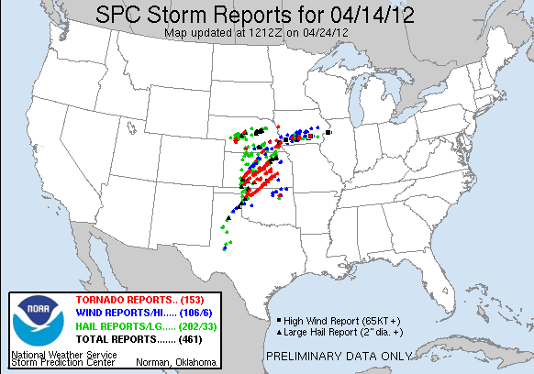
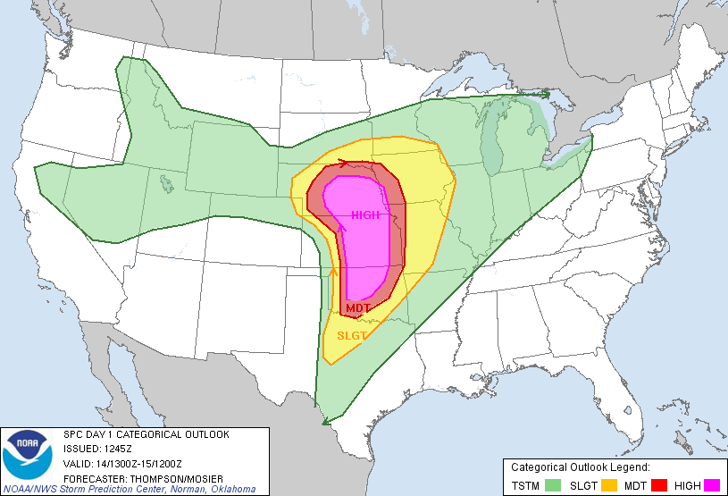

Slide 67
A Few Pointers
Avoid spelling and grammar mistakes.
Poor spelling and grammar reflects poorly on your office and erodes your credibility.
Avoid using subjective descriptions.
Instead of saying “insanely high MLCAPE” say “4000-5000 J/kg MLCAPE”. Keep it scientific!
Always have someone else proofread your discussion.
Read more discussions!
The more you read, the better you’ll write!
Know your audience!
Keep these in mind!

Slide 68
Forecast Journals
Your task:
Use observations and short/long range models to create a series of SPC-style Day 1 convective outlooks.
Each journal will have three parts:
An SPC-style outlook graphic (categorical only, no individual hazards required)
A Day 1 forecast discussion.
Post event verification and discussion
Your forecast journal will NOT be graded on forecast accuracy, but WILL be graded on:
Meteorological concepts and consistency
Incorporation of various observation networks (no model-only forecasts)
Spelling and grammar
Please see the online rubric for further instructions and expectations.

